Slide 1

SpaceXchange
Rent private parking spots
Upload your own parking spot
Navigate to the spot with one tap

Slide 2





Tech Stack

Slide 3
Time for a demonstration

Slide 4
Opportunities for Improvement
Manage your chats
Change the availability for your own parking spot
Edit own parking spots
Reccuring bookings

Slide 5
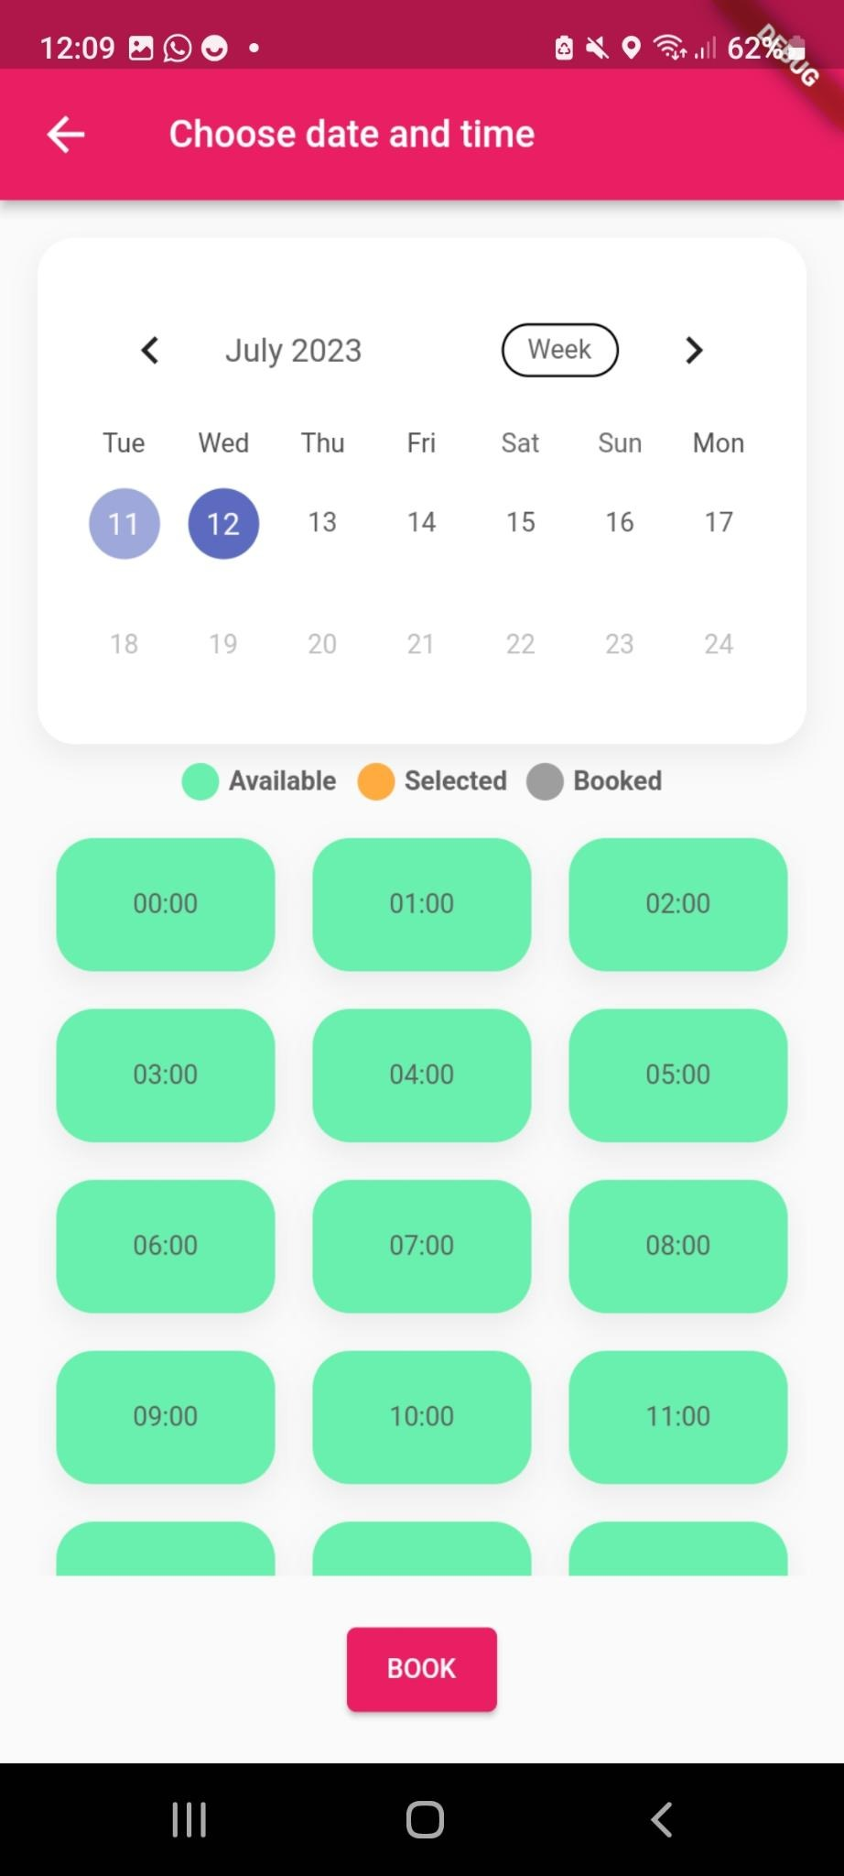
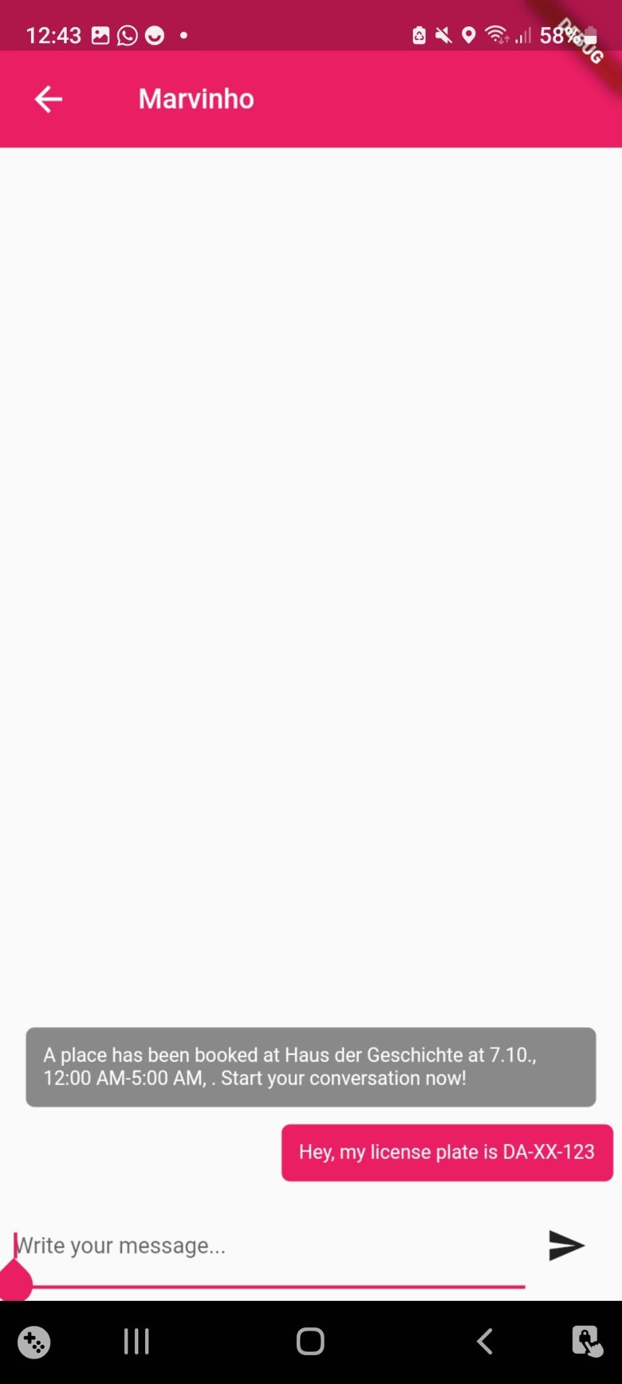
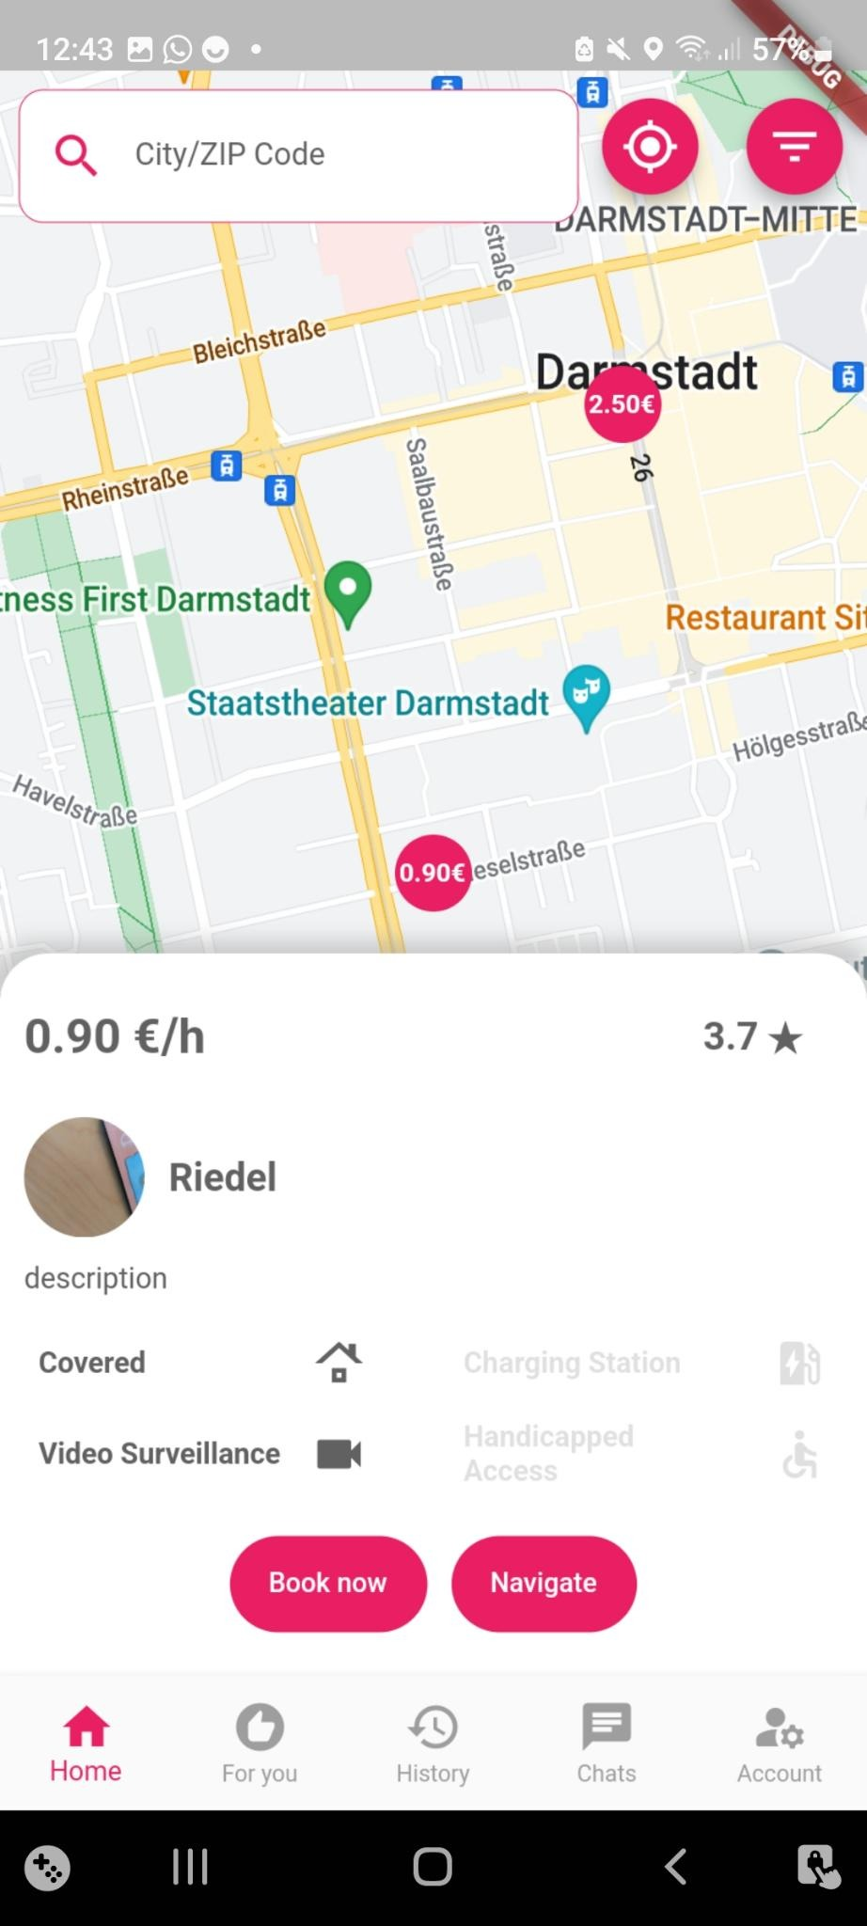
Features
Mandatory Features:
P2P: book a parking spot and upload your own parking spot
Filter for specific features
Reputation with ratings and reviews
Recommendations according to your personal preferences
Notification for the parking spot owner if their spot was booked and for incoming chat messages
Security acquired with Firebase rules for accessing data
Extra Features:
Chat with the parking spot owner
Payment with PayPal
Booking History
Navigation to the parking spot

Slide 6
Testing
Linting
Verifying the building correctness of the app
Unit tests:
Verify individual functions, methods or classes
Use Mockito framework for reliable testing
Integration tests:
Sign up and deletion of an account
Creation and deletion of a parking spot

